Slide 1
MM-GBSA for Docked Small-molecule Ligands
Anjali Dhar
CHEM 101.6 Final Project
06/03/24

Slide 2
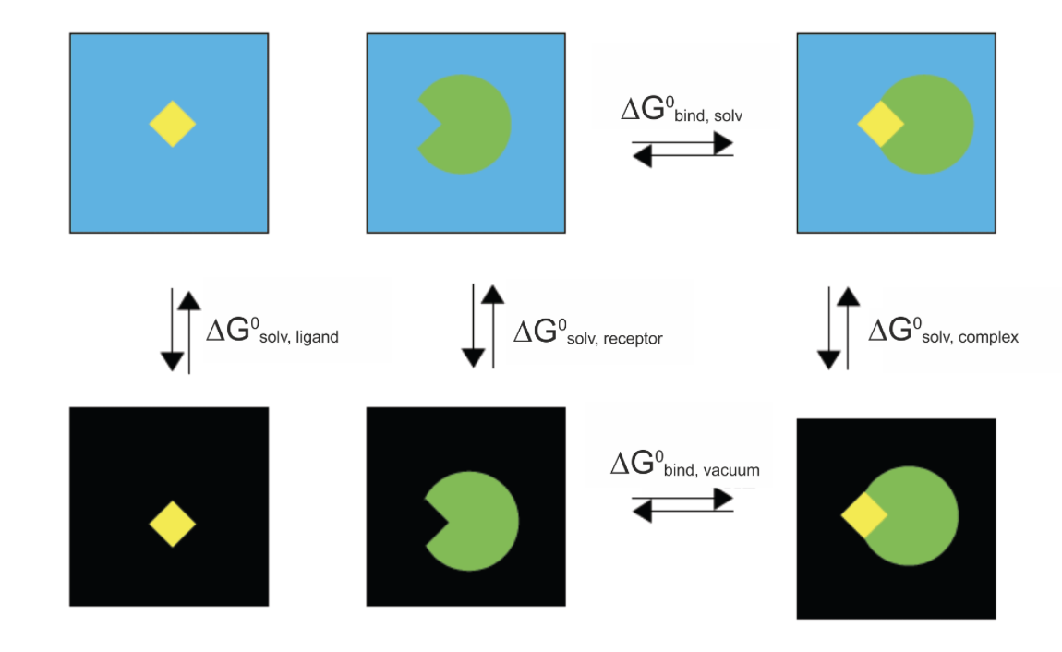
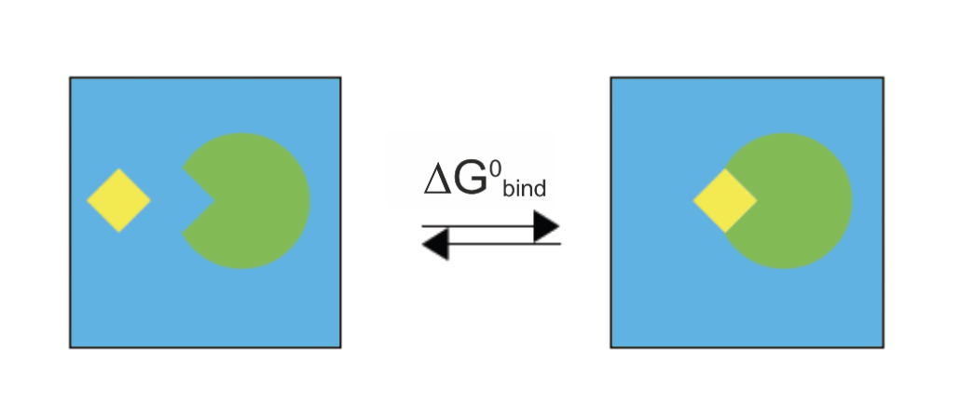
Molecular Mechanics Generalized Born Surface Area (MM-GBSA)
How we get it:
We want free energy of binding!
Using molecular mechanics & the Generalized Born implicit solvation model
Walker, R. and T. Steinbrecher. MM-PBSA. AmberTools24, (2006)
Notes:
For MM: electrostatic / coulombic interactions + vDWs
GB solvation model : electrostatic (based on GB model) and nonpolar (based on SASA) solvation energyes
Less computationally intensive than MM poisson Boltzmann Sufarce area, as it uses an implicit solvent model instead of an explicit one

Slide 3
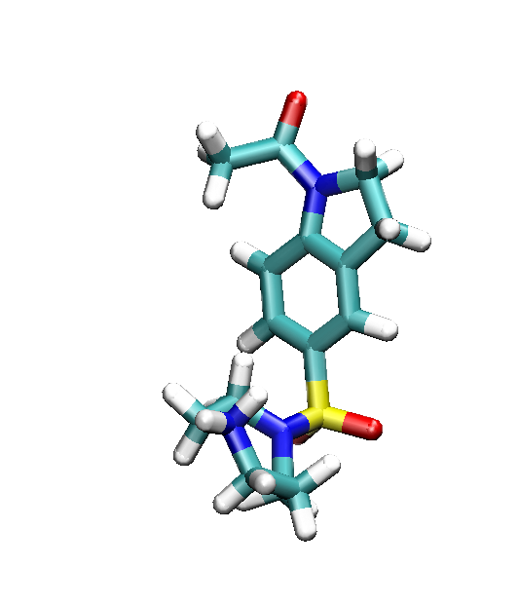
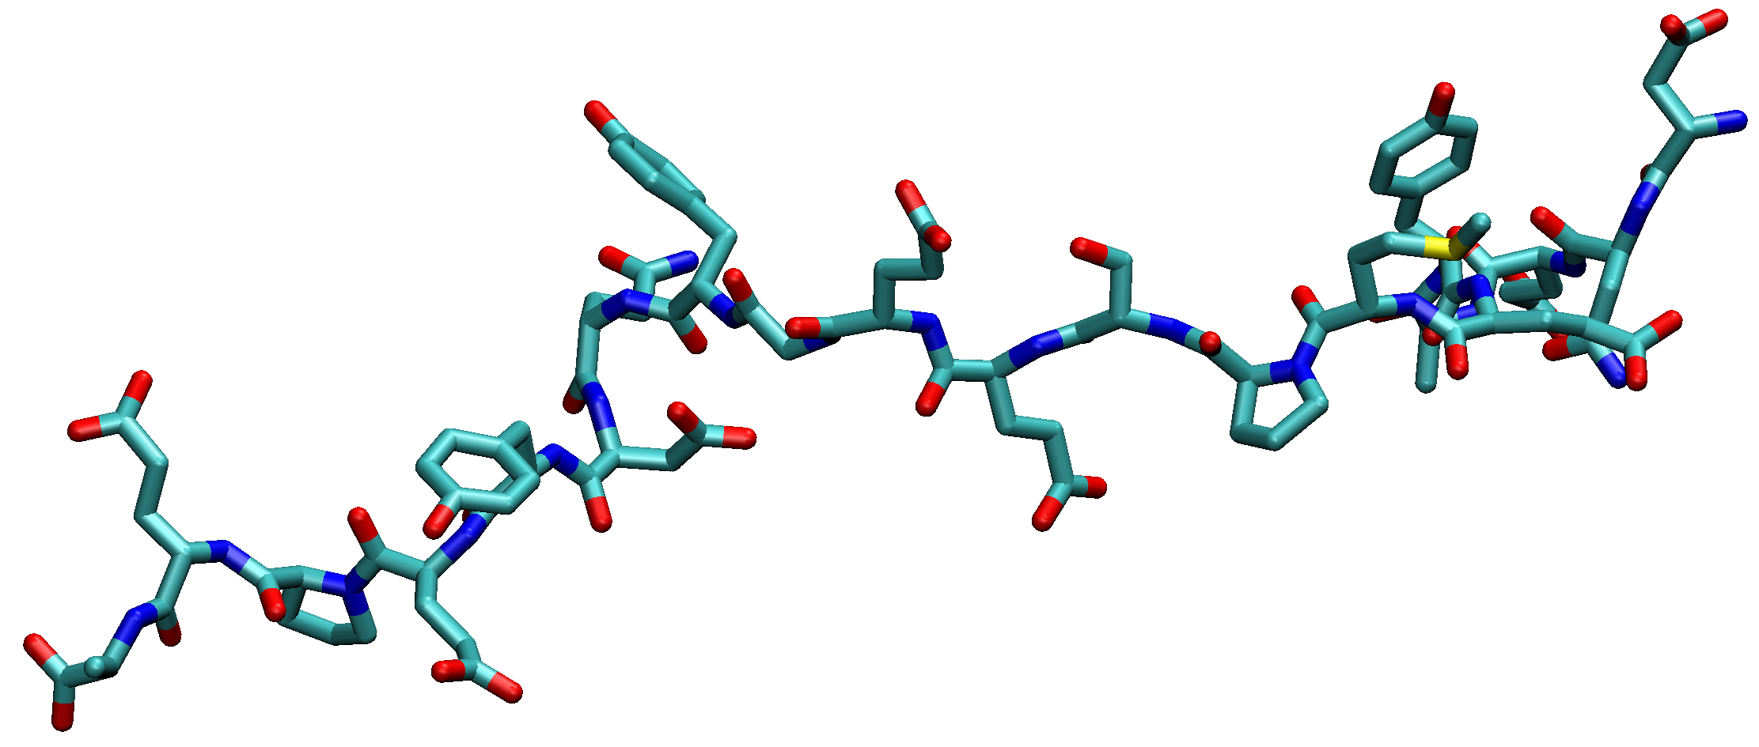
Why do we want to do MM-GBSA?
Docking Score
Molecular Docking
Docking
“search space”
☹
Inexpensive calculation
No entropic consideration
Often omits ligand steric effects
Notes:
Benefits to MMGBSA energies:
Not super expensive
Straightforward (ish)
Provides physically reasonable estimates
Cons:
Approximation of the more accurate MMPBSA

Slide 4
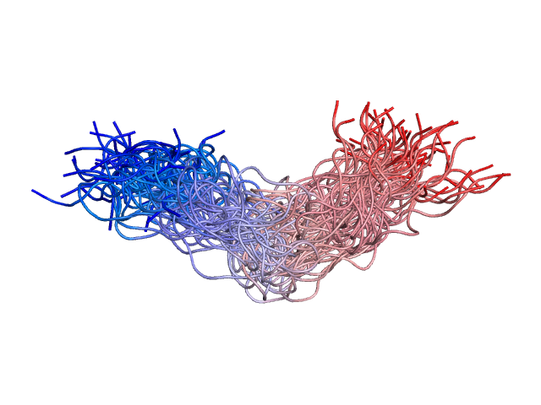
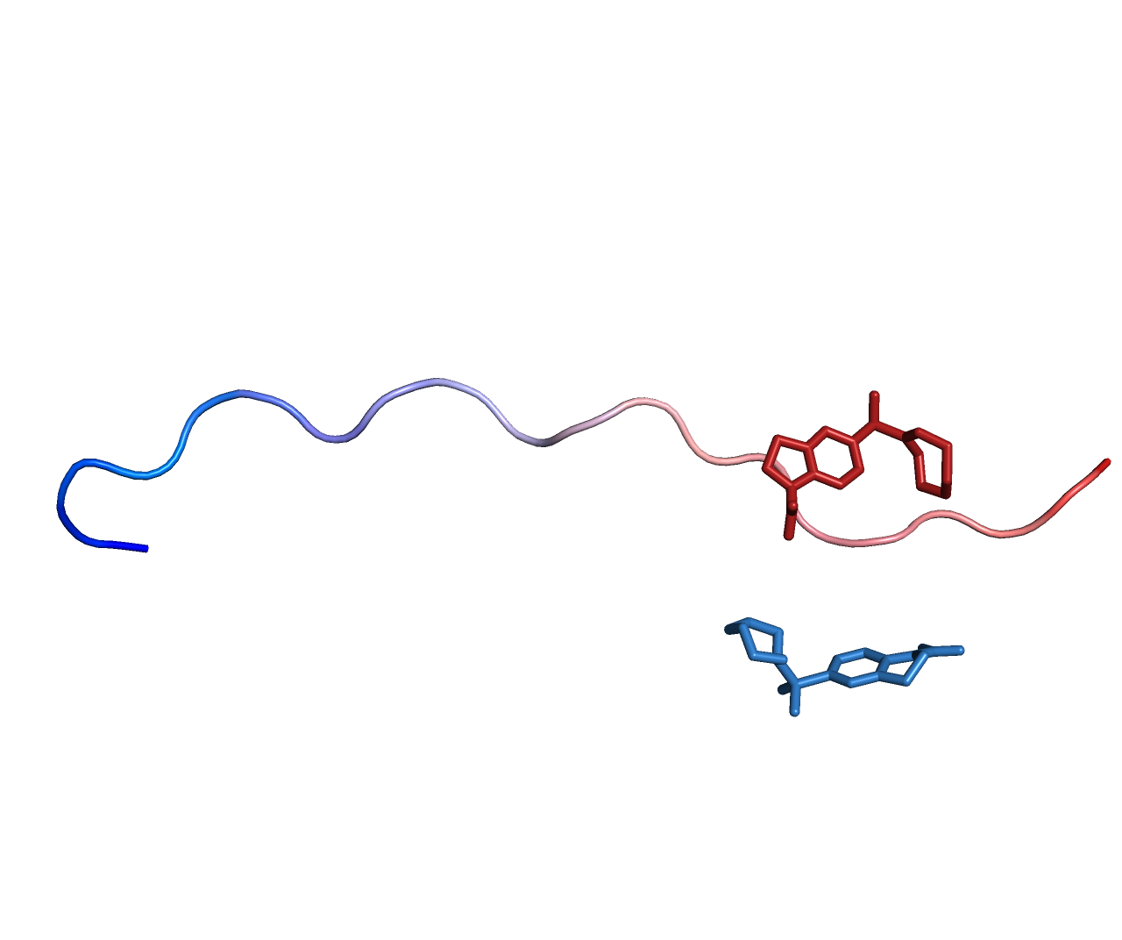
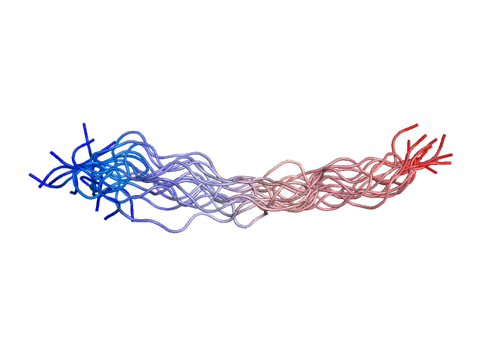
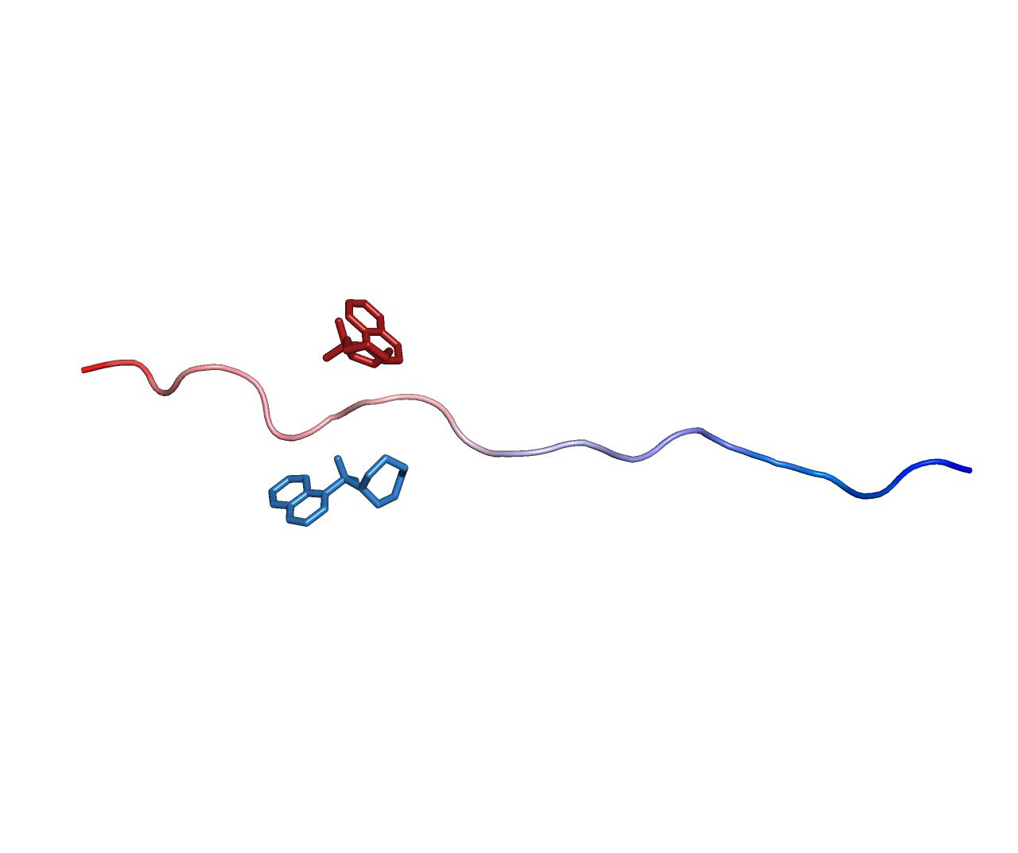
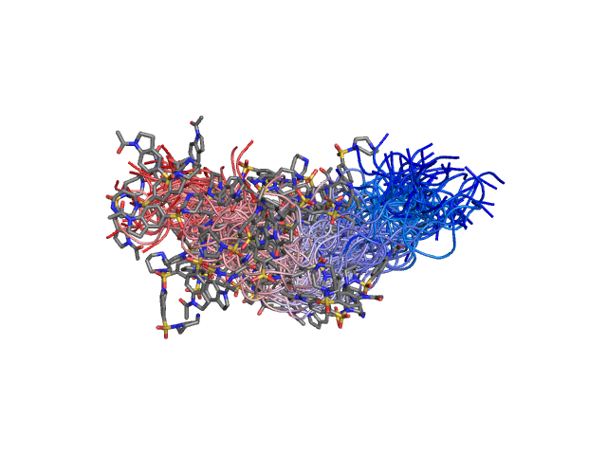
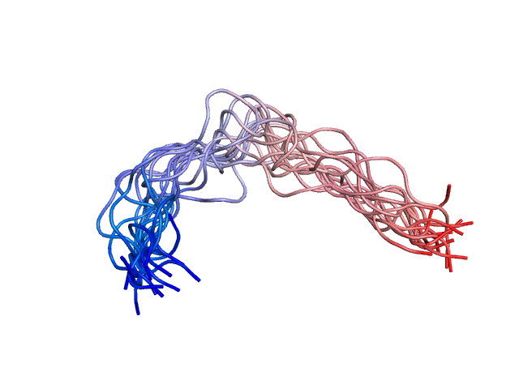
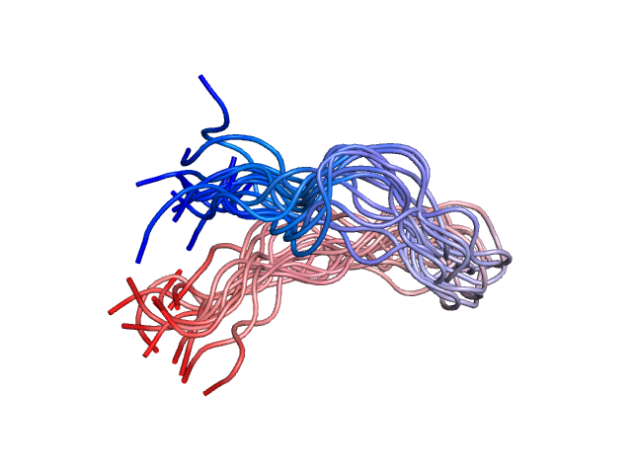
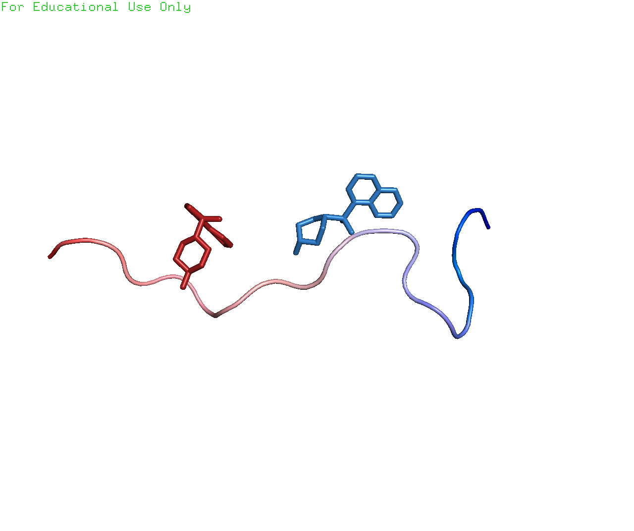
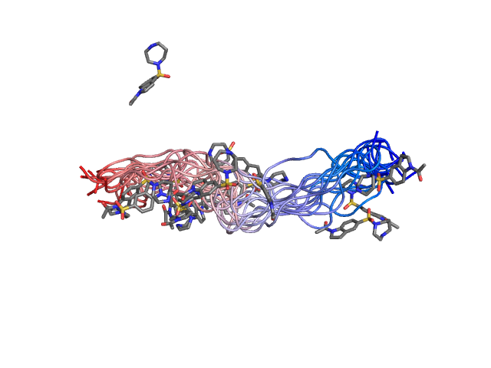
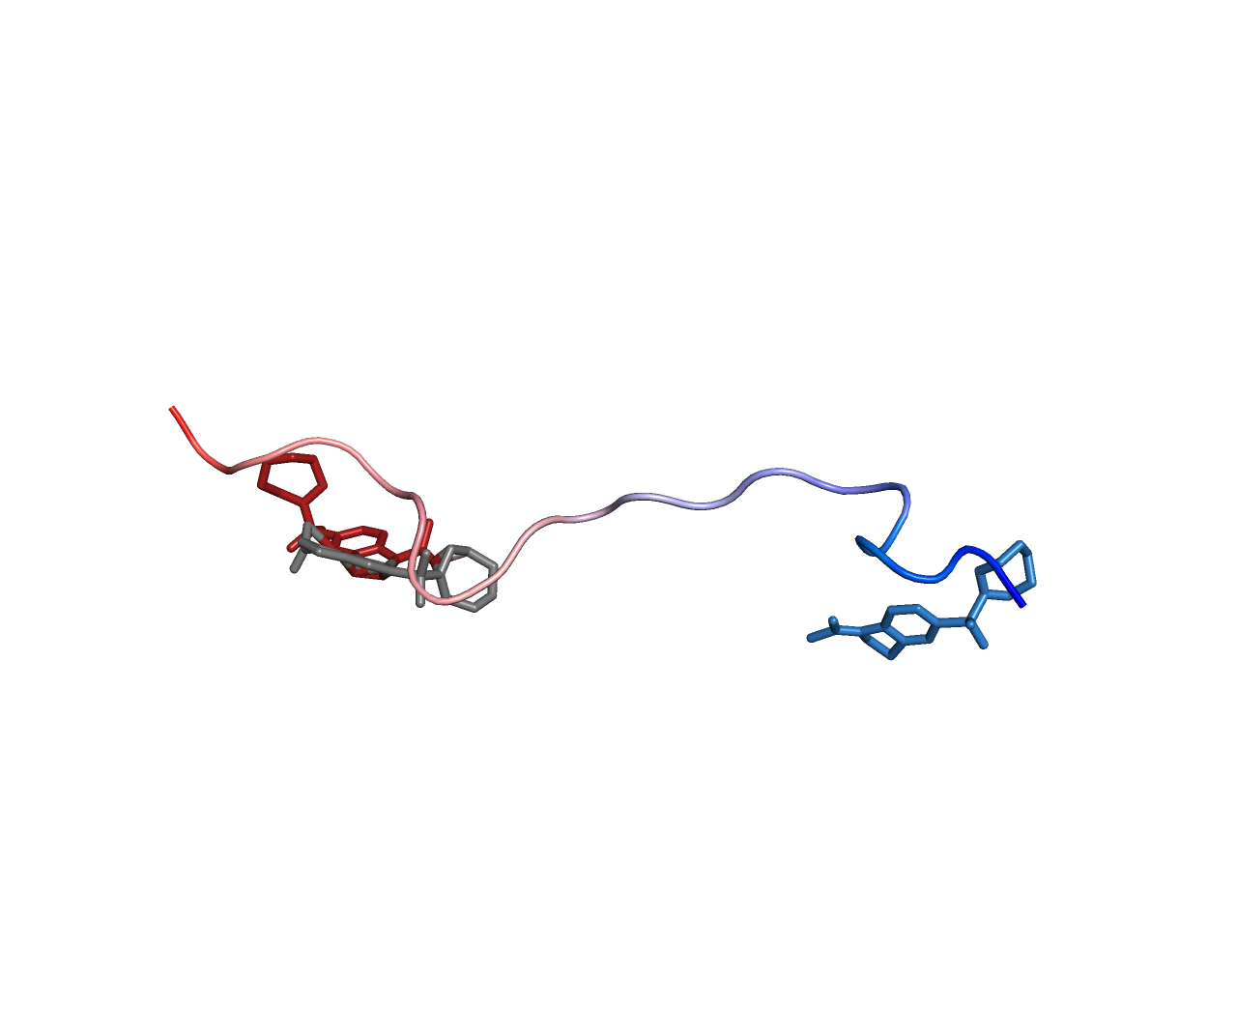
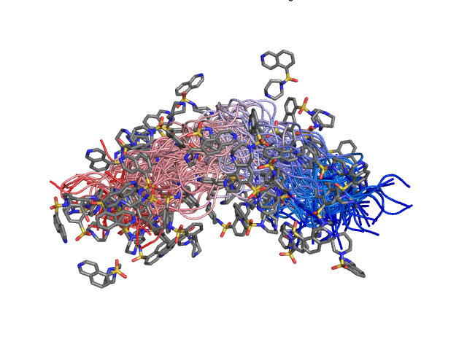
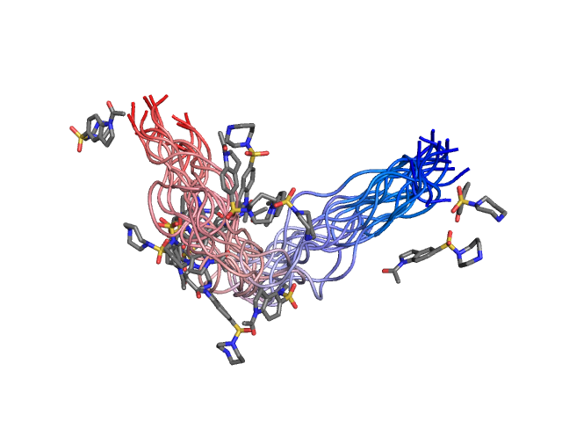
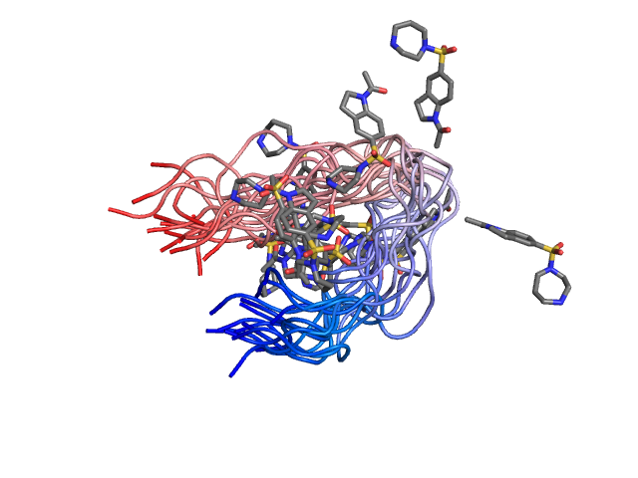
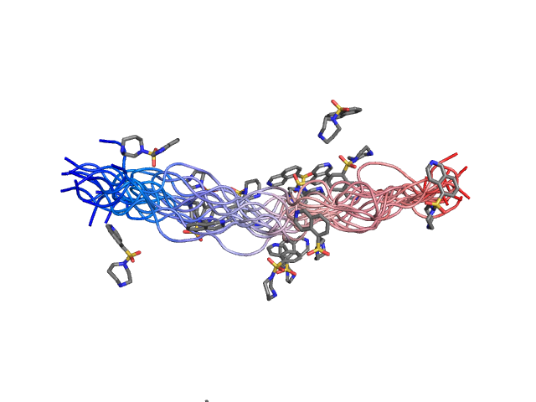
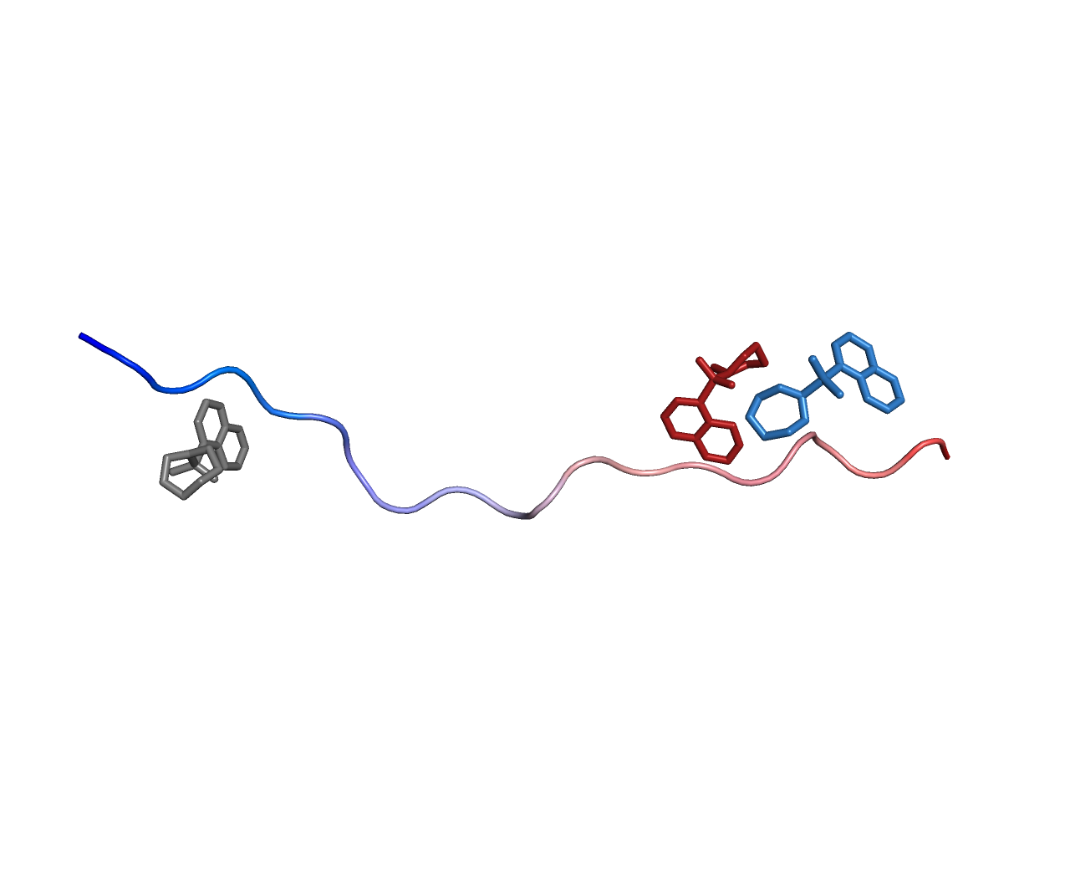
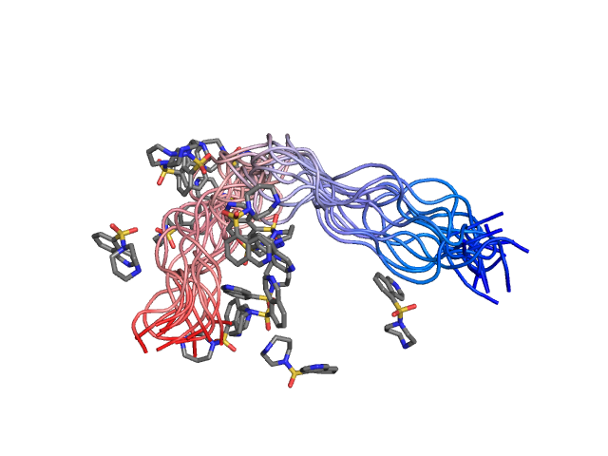
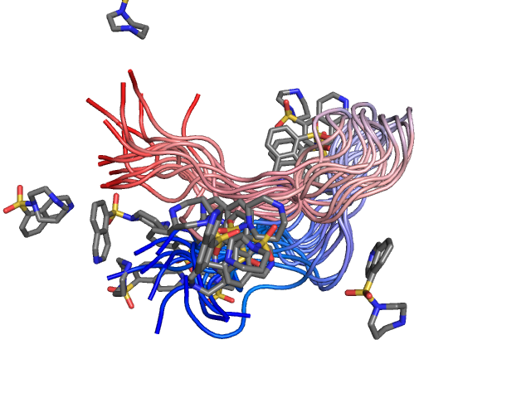
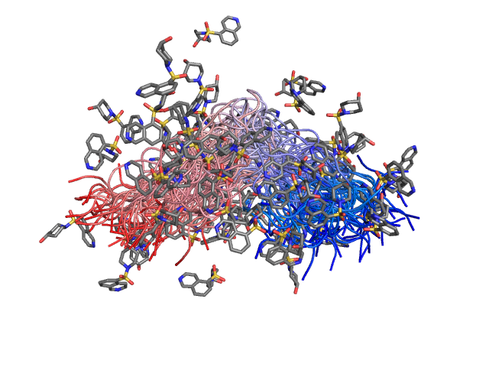
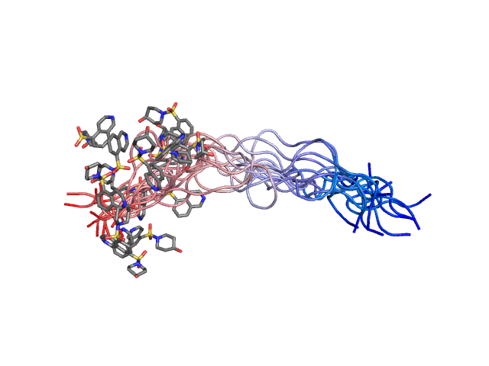
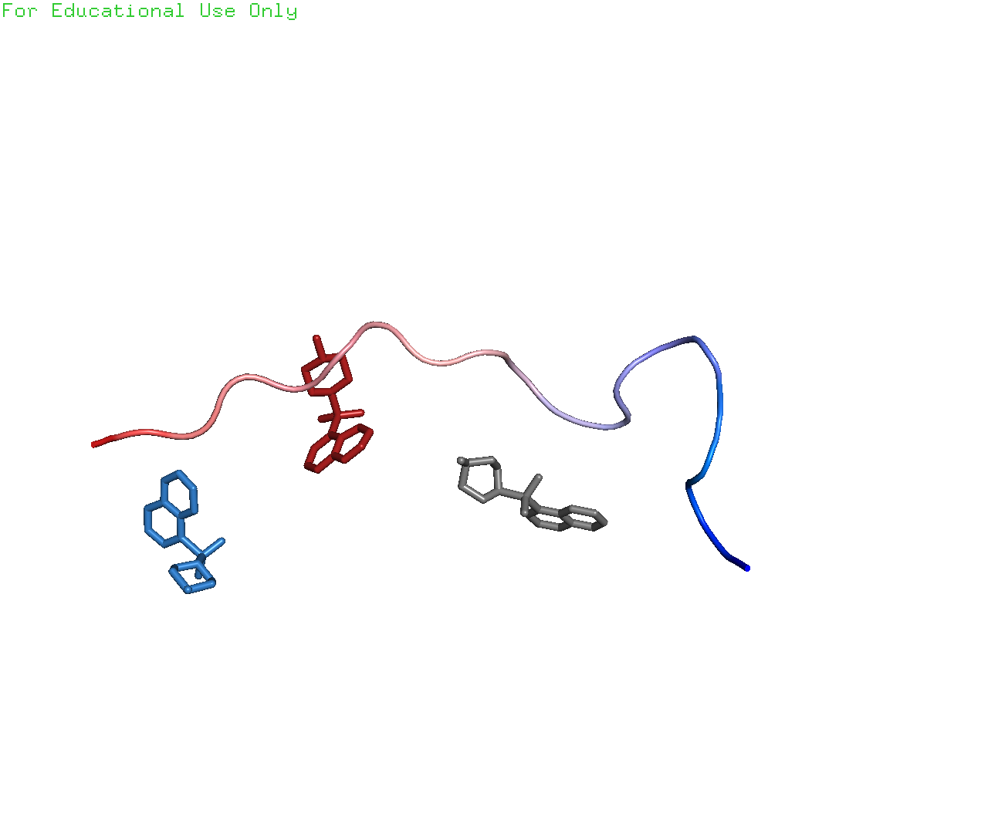
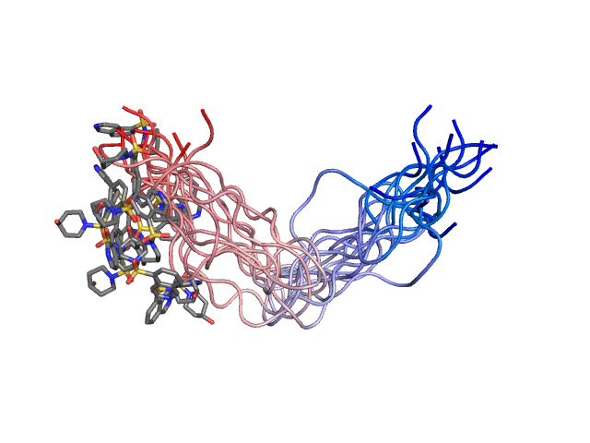
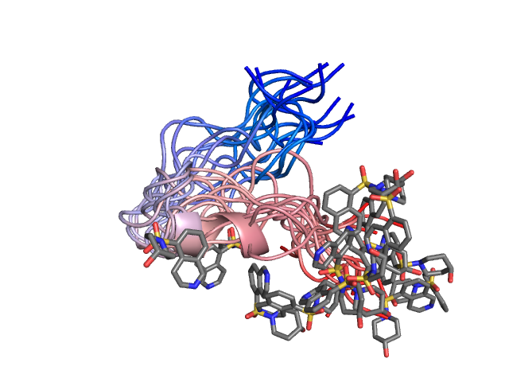
our starting system
MD Simulation
Clustering
Ensemble Docking
Ligand 47
0
Fasudil
9
19
Apo
Ligand 23
0
9
19
Ligand 47
0
9
19
Fasudil
MD
AutoDock
Vina
DiffDock
0
9
19
Ligand 23

Slide 5
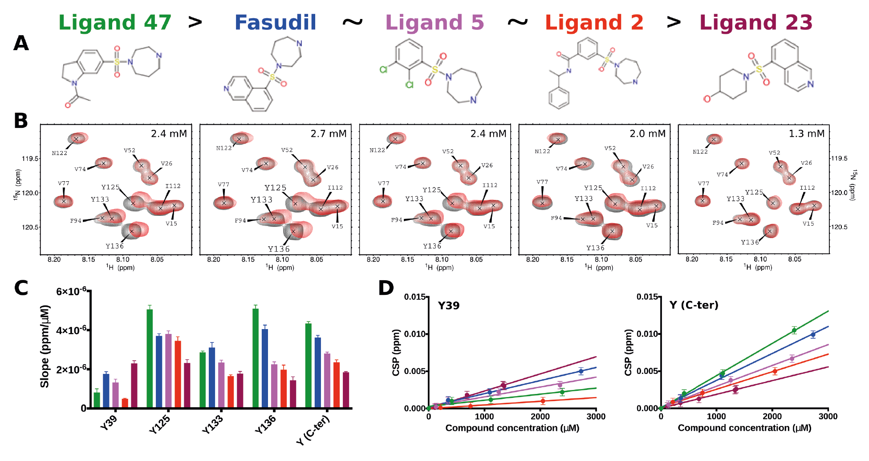
The ligand series
Robustelli et. al., JACS, 2022

Slide 6
The workflow: how AMBER MM-GBSA works
Run the calculation!
Single docked/MD pose
Force field for protein: ff14SB
Force field for ligand: GAFF
inpcrd
prmtop
&
pdb4amber
Fix pdbs, make AMBER files based on force field
Split into protein and ligand

Slide 7
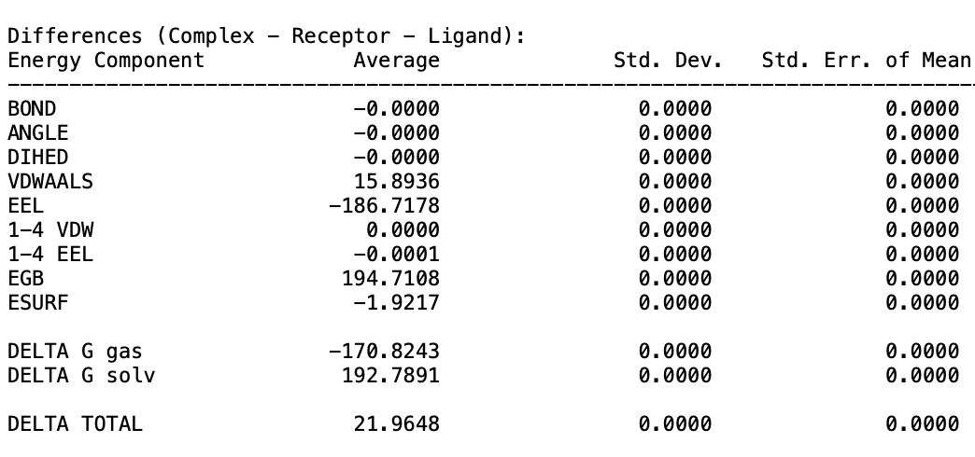
The workflow: an output file
Generalized born electrostatic solvation energy
Electrostatics
(coulombic)
Non-polar solvation energy
Notes:
EGB: solvation free energy based on the Born equation (how the solvation energy changes with the solute's geometry and electrostatic properties)
ESURF: based on the solvent-accessible surface area (SASA)

Slide 8
The workflow
0
9
19
Calculate free energy of binding with
MM-GBSA
Compare energies across cluster bend angle
MD ensemble
0
θ
9
19
Docked ensemble

Slide 9
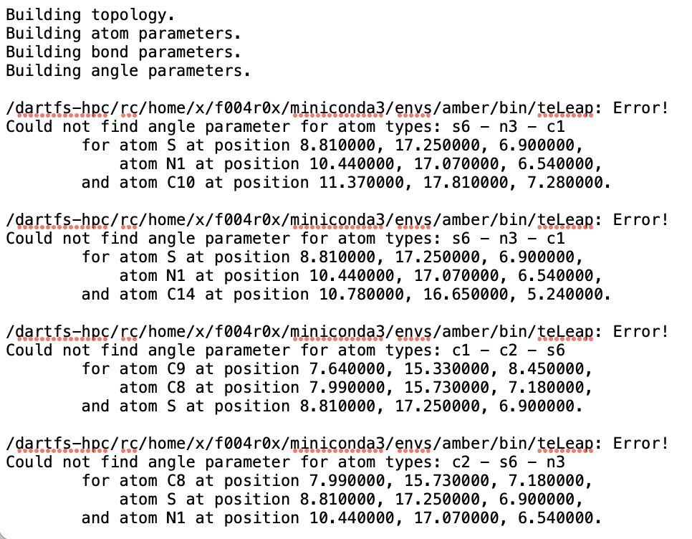
Hiccups: DiffDock sucks ☹
Potential Hypothesis:
DiffDock has weird formatting issue?
Potential fix:
Make compatible with AMBER

Slide 10
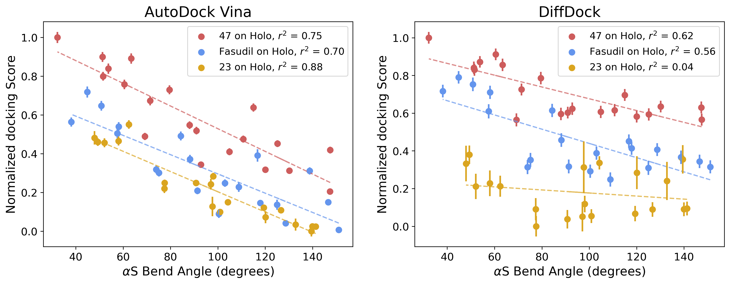
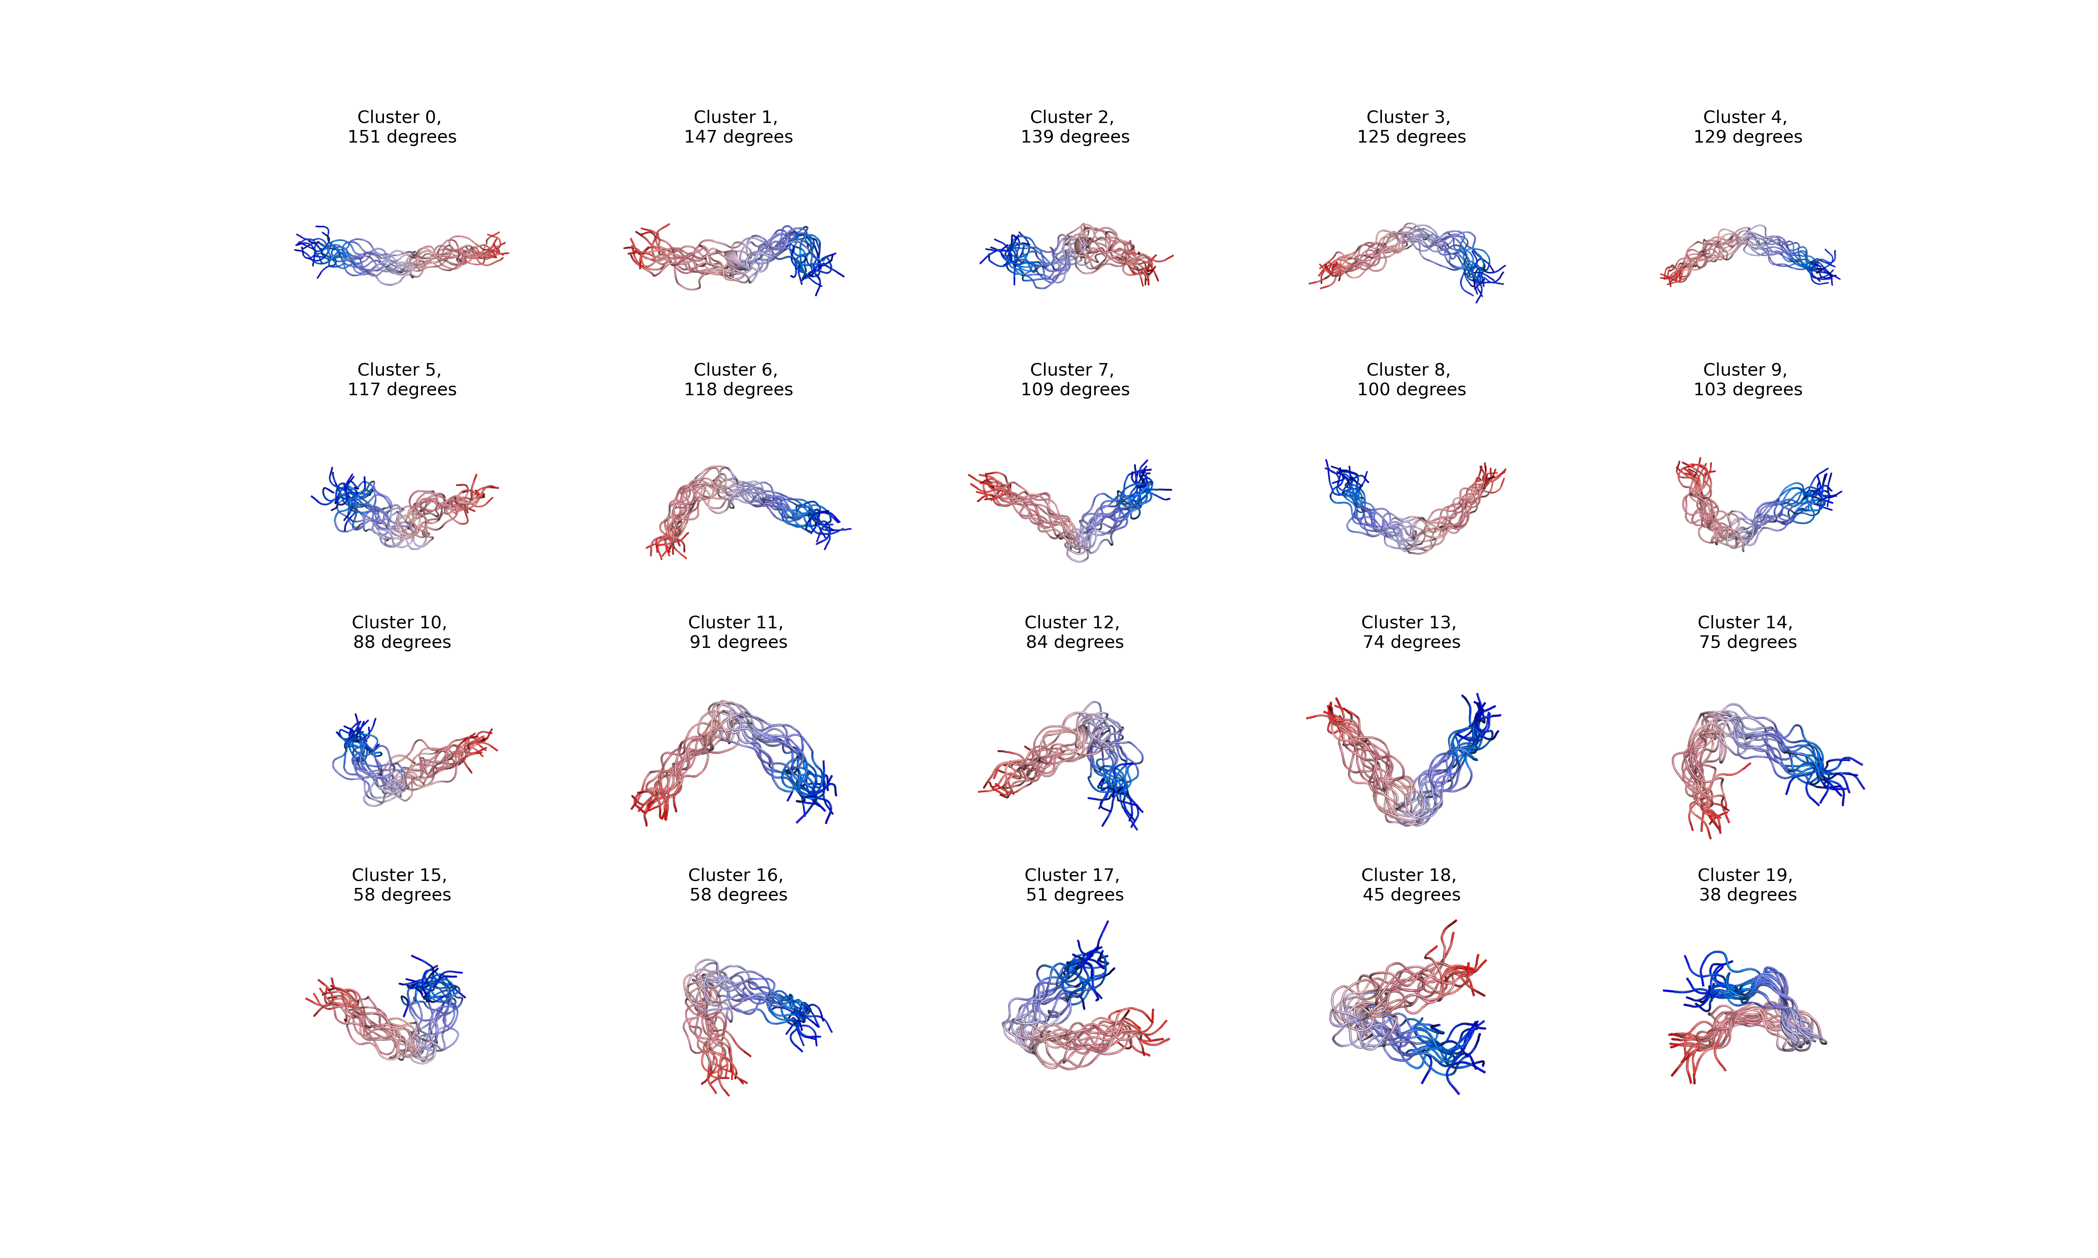
Original normalized scores for docked poses
You suck!

Slide 11
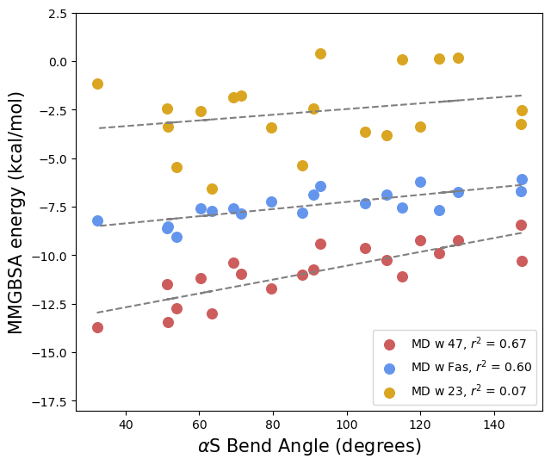
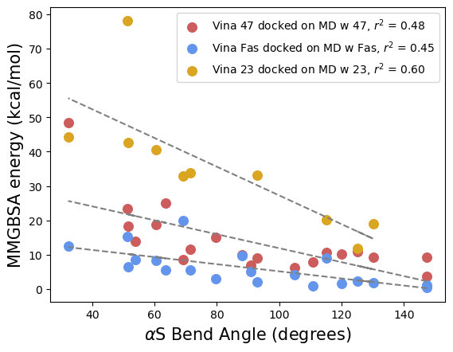
MM-GBSA energies for MD & docked poses
MD ensemble
AutoDock Vina ensemble

Slide 12
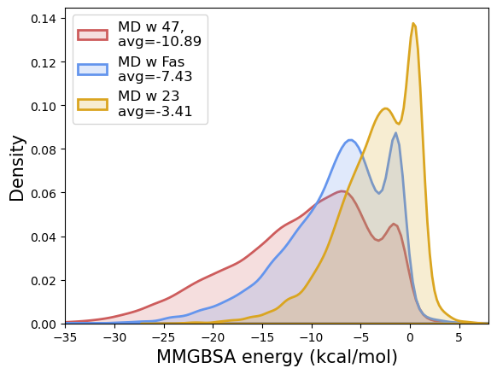
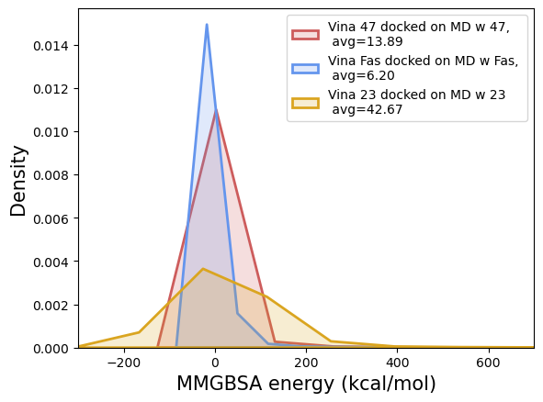
Another look: kernel density estimate plots
MD ensemble
AutoDock Vina ensemble

Slide 13
What’s next
→ Minimize docked pose to reduce negative solvent effects
observed in the docked ensemble
→ Fix improper ligand torsions with frmod to get MM-GBSA
energies for DiffDock

Slide 14
References
Walker, R. and T. Steinbrecher. MM-PBSA. AmberTools24, (2006)
Generalized Born implicit solvent. http://www.ks.uiuc.edu/Research/namd/.
Weng, G. et. al. Assessing the performance of MM/PBSA and MM/GBSA methods. 9. Prediction reliability of binding affinities and binding poses for protein-peptide complexes. (2019)
Guimaraes, C. and M. Cardozo. MM-GB/SA Rescoring of Docking Poses in Structure-Based Lead Optimization. (2008)

